Slide 1
Matlab Tutorial
Ying shen
School of software engineering
tongji university

Slide 2
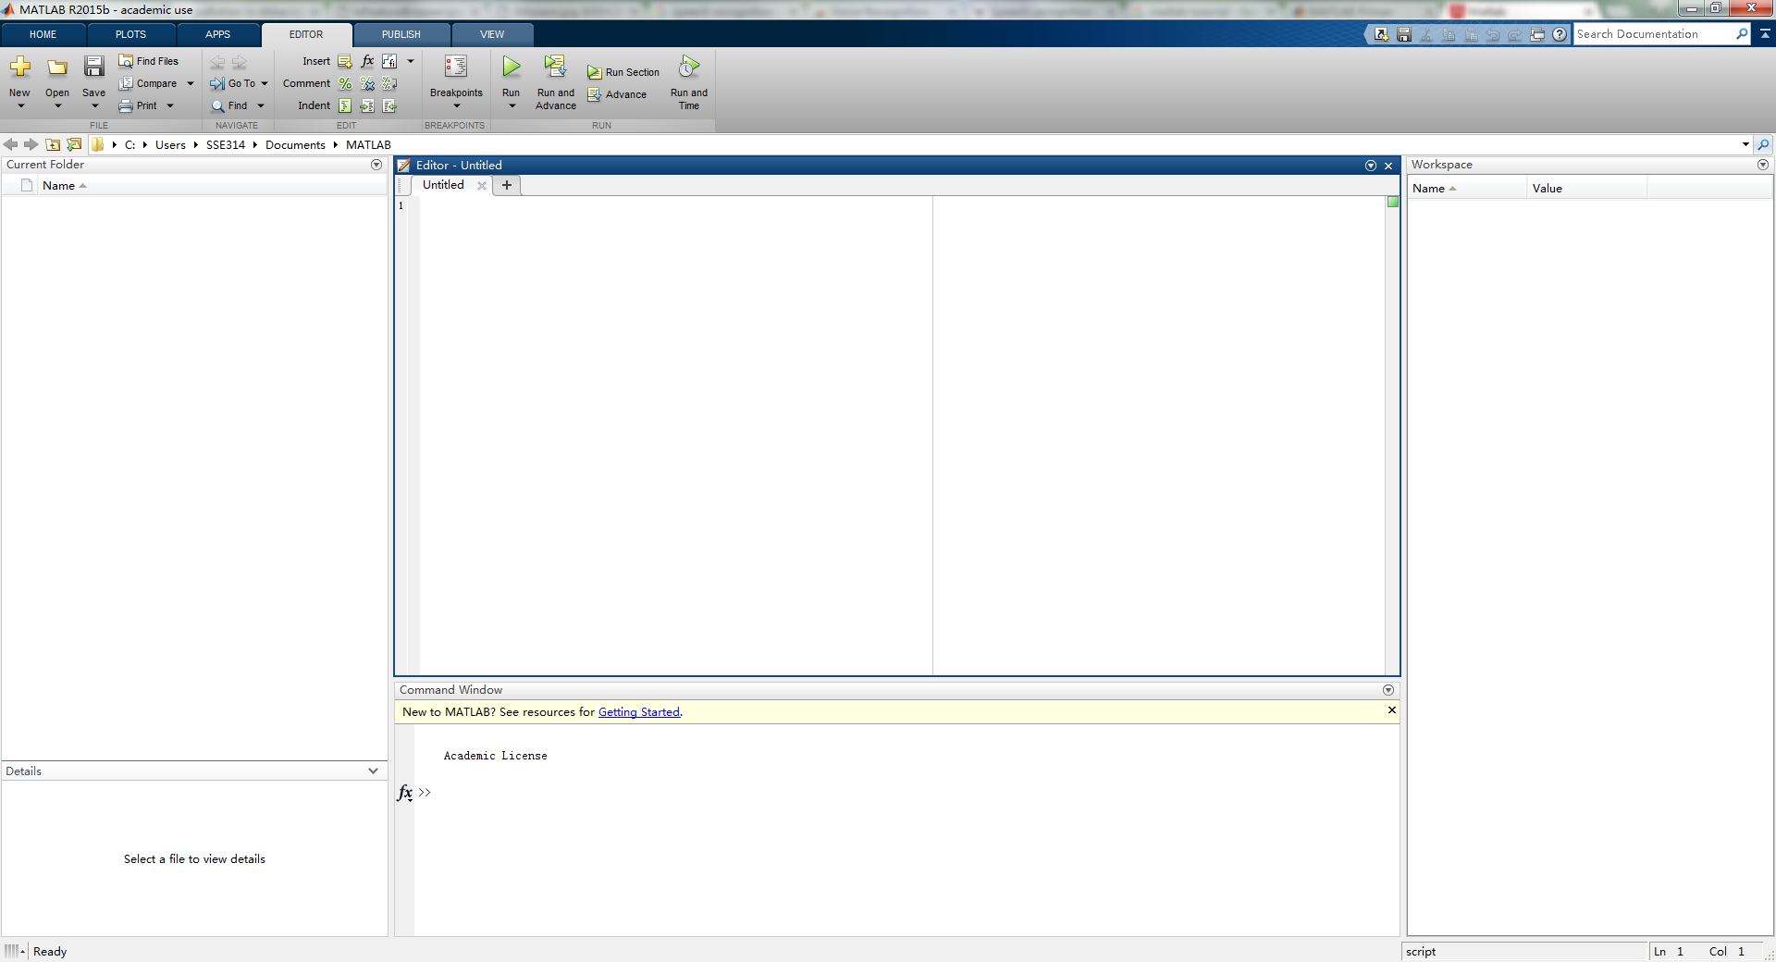
Development Environment
Current working directory
Script editor
Workspace
Command window
Notes:
The desktop includes these panels: • Current Folder — Access your files. • Command Window — Enter commands at the command line, indicated by the prompt (>>). • Workspace — Explore data that you create or import from files.

Slide 3
Commands
Create a variable
a = 1
b = 2
c = a+b
d = cos(a)
sin(a)
e = a*b;

Slide 4
Character Strings
Assign a string to a variable
myText = 'Hello, world'; % disp(myText);
otherText = 'You''re right' % disp(otherText);
f = 71;
c = (f-32)/1.8;
tempText = ['Temperature is ',num2str(c),'C'] % disp(tempText)

Slide 5
Calling Functions
Functions
A = [1 3 5];
max(A)

Slide 6
Loops and Conditional Statements
Within a script, you can loop over sections of code and conditionally execute sections using the keywords for, while, if, and switch
nsamples = 5;
npoints = 50;
for k = 1:nsamples
currentData = rand(npoints,1); % create an array with
% random values
sampleMean(k) = mean(currentData); % mean value
end
overallMean = mean(sampleMean)

Slide 7
Matrices and Arrays
Array Creation
a = [1 2 3 4] % a row vector
a = [1 2 3; 4 5 6; 7 8 10] % a square matrix
z = zeros(5,1) % a column vector containing 5 zeros
Matrix and Array Operations
a + 10
sin(a)
a'
p = a*inv(a)
p = a.*a

Slide 8

Matrices and Arrays
Concatenation
A = [a, a]
A = [a; a]
Array indexing
A = magic(4) % a 4*4 magic square
A(4,2)
A(8)
A(4,2) = 17
A(3,:)
16 2 3 13
5 11 10 8
9 7 6 12
4 14 15 1
A =

Slide 9

Matrices and Arrays
Deleting Rows and Columns
A(:, 2) = [] % A is a 4*3 matrix
16 3 13
5 10 8
9 6 12
4 15 1
A =

Slide 10
Draw Lines
Draw a line
x = 0:pi/100:2*pi;
y = sin(x);
figure % opens new figure window
plot(x,y)

Slide 11
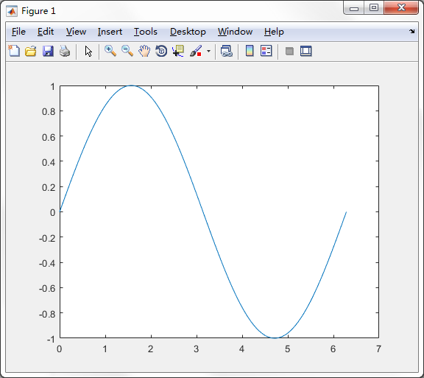
Draw Lines
Draw a line
x = 0:pi/100:2*pi;
y = sin(x);
figure % opens new figure window
plot(x,y)

Slide 12
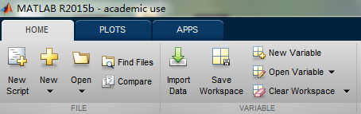
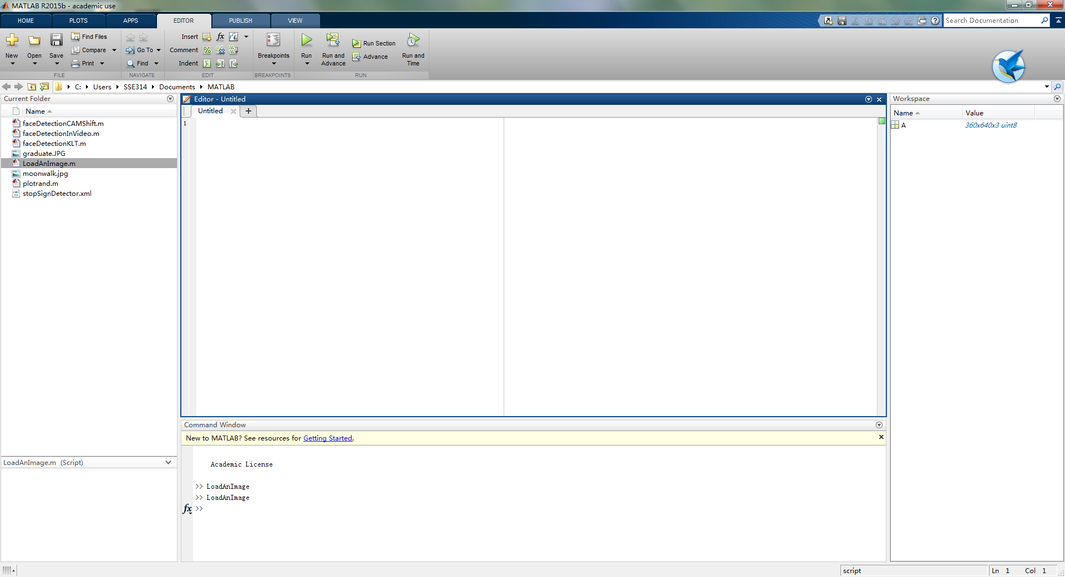
Programming and Scripts
Create a new script

Slide 13
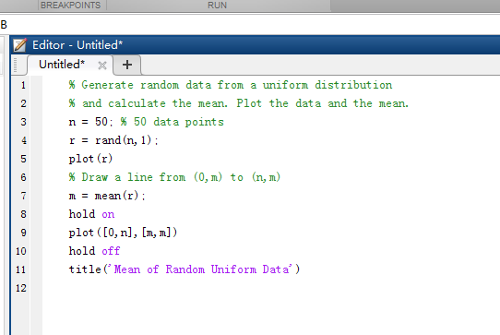
Programming and Scripts
A sample script

Slide 14
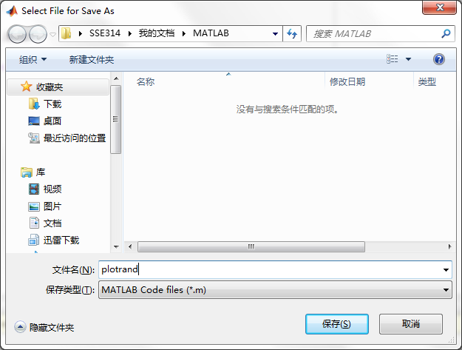
Programming and Scripts
Save the script

Slide 15
Programming and Scripts
Run the script

Slide 16
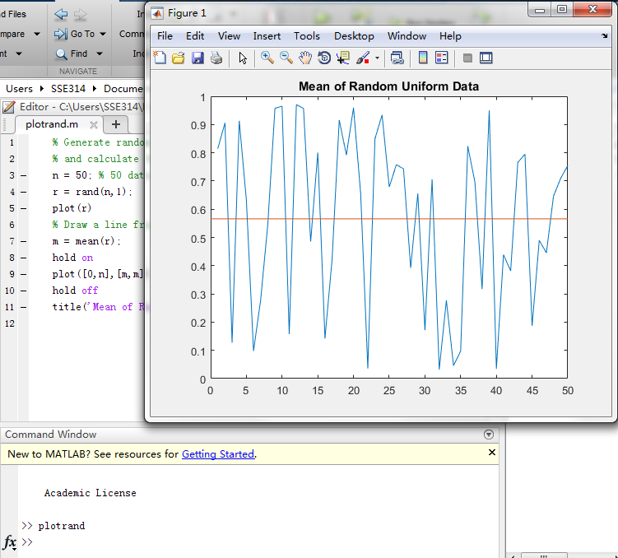
Programming and Scripts
Run the script

Slide 17
Programming and Scripts
Set a breakpoint

Slide 18
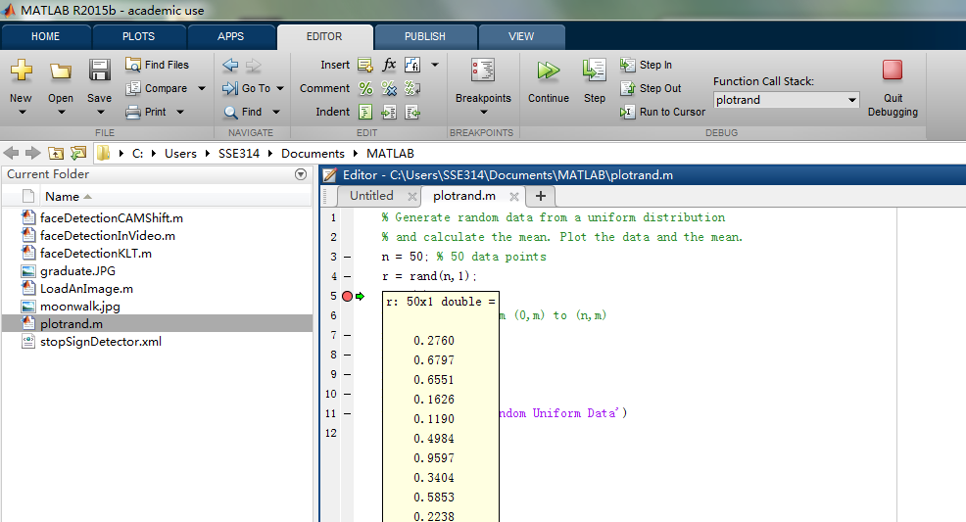
Programming and Scripts
Set a breakpoint

Slide 19
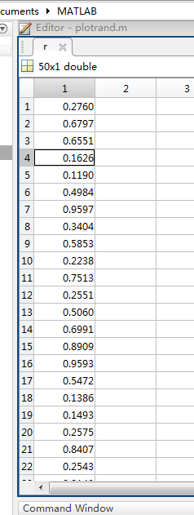
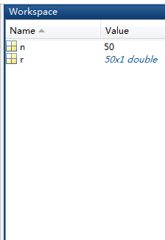
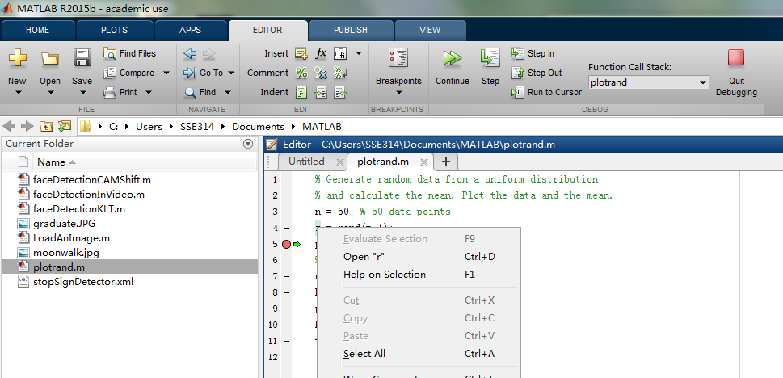
Programming and Scripts
Set a breakpoint

Slide 20
Exercise
Run previous examples
Finish the following task:
Draw an oval; (x=acos(θ) y=bsin(θ))

